Slide 1


Roman Oppermann
08.03.2022

Slide 2

Outline
Executive Summary
Introduction
Methodology
Results
Conclusion
Appendix

Slide 3
Executive Summary
Goal of the Project: Estimate if Falcon 9 stage 1 would land successfully or not
This fact plays major role in estimate the price of its launch
Data for the estimation was sourced from SpaceX REST API and the Falcon 9 Wikipedia Page
Process to achieve the Goal after collecting the data:
Perform some data wrangling to determine the best predictors for our outcome
Exploratory Data Analysis and feature scaling to visualize the data and get an overview of it
Calculating and evaluation of four different machine learning models to find the best one for the goal of the project
The results shows that the outcome depents on various parameters
Launch factors: Launch site, payload mass, target orbit
Technical factors: gridgins, cores

Slide 4
Introduction
Space X is able to reduce the cost of launch of the Falcon 9 Rocket to 62 million dollars due to reuse the Stage 1
Other competitors need 165 million dollars for a rocket launch
Space X is by this fast in the moment the leader of the space race
The goal of this project is to build up a machine learning pipeline to predict, if the first stage will land successfully
To Predict, if the first stage will successfully, all factors and their impacts need to be defined
All interactions between the factors need to be find
From Results of the machine learning pipeline can be say which job can be accomplished safely

Slide 5

Section 1

Slide 6
Methodology
Data collection methodology
Diretly from SpaceX’s REST API and with web scrapping from the Falcon 9 Wikipedia
Perform data wrangling
Handling of missing values (drop or replaced) and adding column for summarize if landing was successfully as Preparation for the classification models
Perform exploratory data analysis (EDA) using visualization and SQL
Perform interactive visual analytics using Folium and Plotly Dash
Perform predictive analysis using classification models
Data got prepared to use with four Classification models (SVM, logistic regression, tree classifier and k-nearest neigbours) and got evaluate with several performance indicators like Score, Jaccard, F1-score and LogLoss

Slide 7
Data Collection
The dataset was collected on two different ways
SpaceX Rest API: All Data about rockets, launchpad and payload got requested and then reduced to all Information to Falcon 9 rockets
Webscrapping of Falcon 9 Wikipedia Page: Collected all Data of Falcon 9 Wikipedia which stand there in Tables

Slide 8
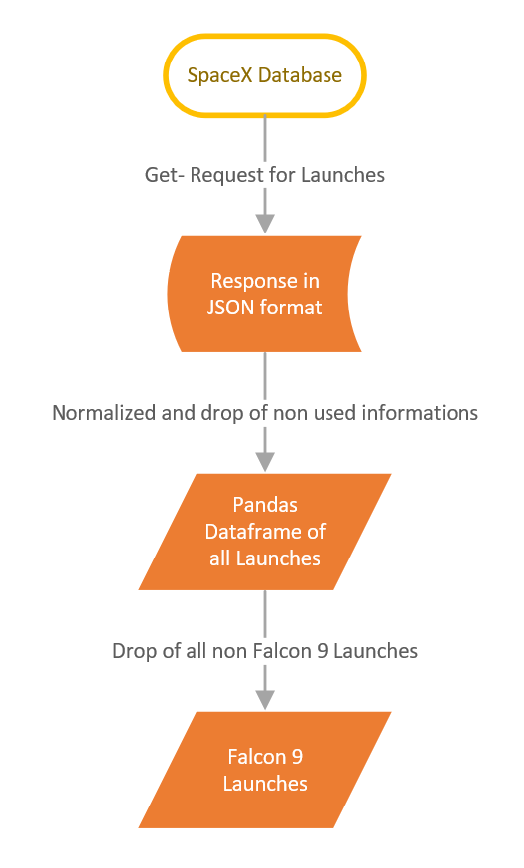
Data Collection – SpaceX API
The left side presented flowchart show the data collecting process from the Space X REST API
The Data get requested from the API, normalize and converted to a Pandas dataframe
Jupyter Notebook on GitHub

Slide 9
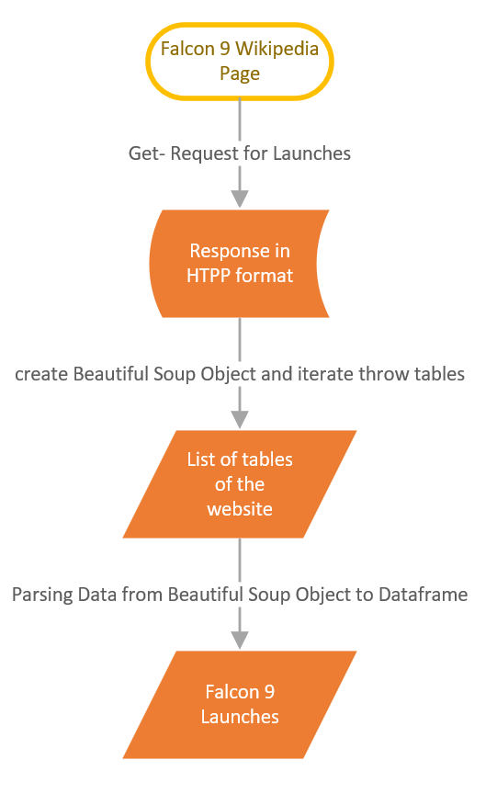
Data Collection - Scraping
Using webscrapping to get informations from the launch tables of the Falcon 9 Wikipedia Pages
Jupyter Notebook on GitHub

Slide 10
Data Wrangling
The collected data needed to transferred in the right format, p. a. the date format or missing information need to get replace by the mean value of that column, p. a. the payload of the rockets.
Also new columns need to get create to get a new basis to achive the goal of the goal of the work. So it needed to create a column which contains the information, if a landing was successful displayed by 0 and 1 in Preparation for the machine learning models
Link: Replacement missing information by the mean of the column
Link: Creating column of successful landing in Preparation for machine learning

Slide 11
EDA with Data Visualization
Used Scatter point charts to see, if there is an relationship between Launch Site and Flightnumber or Payload Mass and the Outcome of Landing → Scatter point chart allow to visualize three information an the same time
Used a bar chart to visualize the outcome of the landing and the orbit where the payload got transport to
Used a line chart to visualize the development of successful outcomes over years. The line chart is easy to interpret the information to see a trend
All charts and the codes are here

Slide 12
EDA with SQL
Following SQL request got performed to get deeper in the Data:
Display the names of the unique launch sites in the space mission
Display 5 records where launch sites begin with the string 'CCA’
Display the total payload mass carried by boosters launched by NASA (CRS)
Display average payload mass carried by booster version F9 v1.1
List the date when the first successful landing outcome in ground pad was acheived.
List the names of the boosters which have success in drone ship and have payload mass greater than 4000 but less than 6000
List the names of the boosters which have success in drone ship and have payload mass greater than 4000 but less than 6000
List the names of the booster_versions which have carried the maximum payload mass. Use a subquery
List the failed landing_outcomes in drone ship, their booster versions, and launch site names for in year 2015
Rank the count of landing outcomes (such as Failure (drone ship) or Success (ground pad)) between the date 2010-06-04 and 2017-03-20, in descending order
All results are to find there

Slide 13
Build an Interactive Map with Folium
Added markers and line
Markers: Launch Sites, Launches with the outcome of the landing, distances to the shoreline, the next highway, city, railways
Line: show the distance to the shoreline, the next highway, city, railways
The object get display to show location of the launch site, their impact of the landing outcome and there location to the normal infrastructure to show that these are special places on special zone on the earth
The Map and the code are to find here

Slide 14
Build a Dashboard with Plotly Dash
Following plots/graphs and interactions got added:
Drop-down menu to select the launch site that the user can separate the launch sites
Range-slider to choose the range of payload that the user can select the payload range what he needs and give him with the interactive pi and the scatter plot more depth according to his needs
Interactive pie chart showing the success rate of all launch sites
Scatter plot showing launch outcomes of all sites according to their payload
Python File is to find here

Slide 15
Predictive Analysis (Classification)
The dataset got split in a train and test set, with the test set the machine learning models got created and evaluated with the test set
Following ML models were used: logistic regression, SVM, decision tree and KNN
For the evaluation following methos were used: Score, Jaccard, F1 and LogLoss (which only can use for logistic regression)
The best ML models were logistic regression, SVM and KNN with a Score of 0.83
All Results and the Code is here

Slide 16
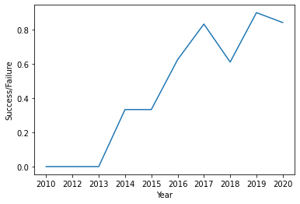
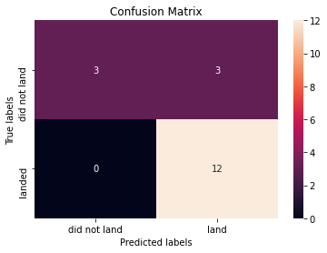
Results
Success / Failure over the Years
Confusion Matrix of KNN ML model

Slide 17

Section 2

Slide 18
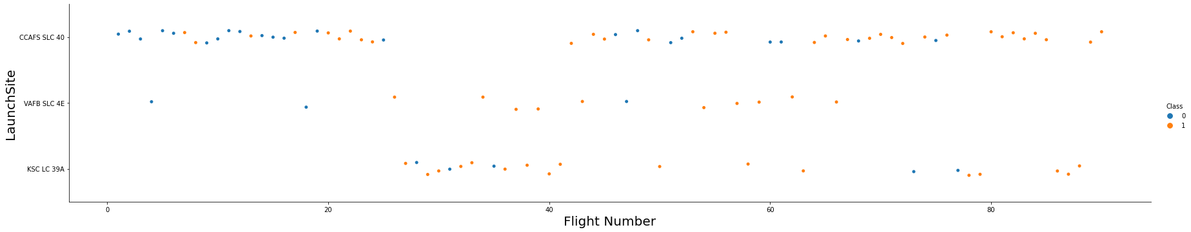
Flight Number vs. Launch Site
CCAFS SLC 40 most used Launch Site and got used nearly the whole Time
VAFB SLC 4E just used rarely but have a good success/ failure rate
KSC LC 39A got intruced later and is also not that often in use
With increasing number of starts the success rate is rising

Slide 19
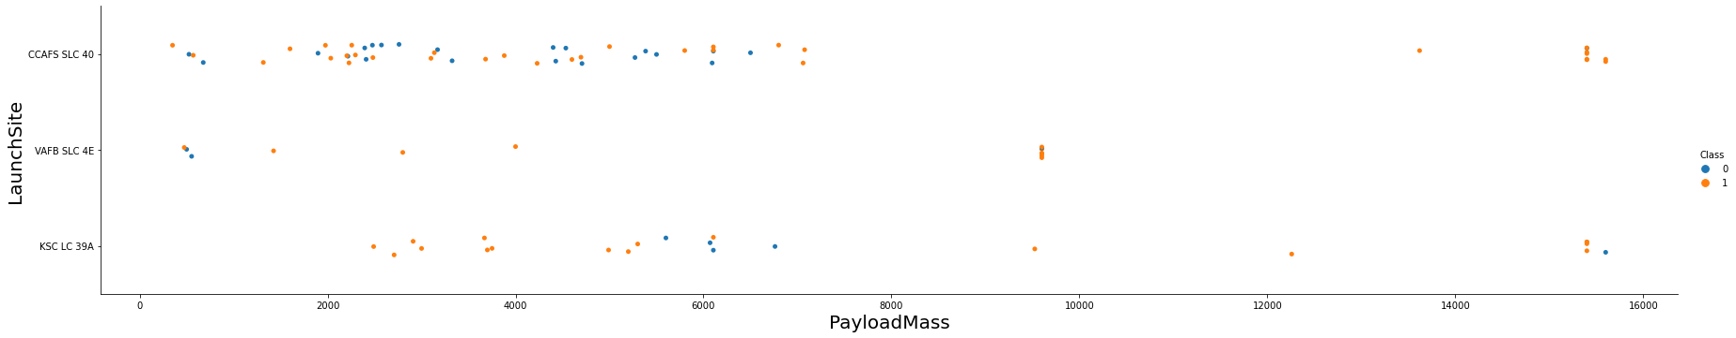
Payload vs. Launch Site
CCAFS SLC 40 and KSC LC 39A are used for Launches with the highest payload mass
The maximum payload mass of VAFB SLC 4E is under 10 000
With higher payload mass the success rate increase, which also indicates that higher payload mass came with increasing flight numbers

Slide 20
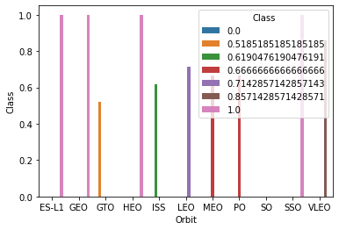
Success Rate vs. Orbit Type
ES-L1, GEO, HEO and SSO have a high chance of success

Slide 21
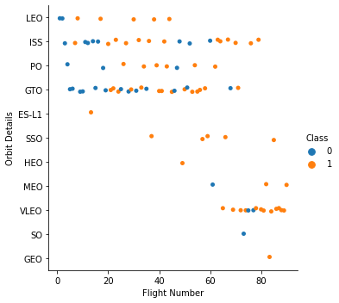
Flight Number vs. Orbit Type
The most flights were to GTO, ISS and VLEO
ES-L1, SO and GEO got achived only once each
ES-L1, SSO, HEO, GEO have a 100% success rate

Slide 22
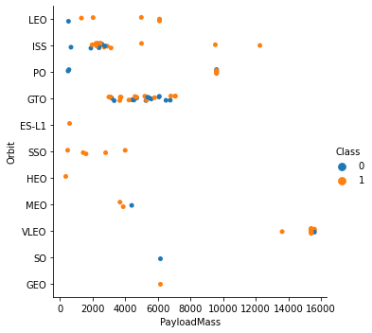
Payload vs. Orbit Type
Highest payload mass got send to VLEO with good success rate
Most flights to the ISS had a payload mass between 2000 and 4000
Most flights to FO had a payload mass between 2000 and 8000

Slide 23
Launch Success Yearly Trend
In general: By Time the succes rate increase
Between 2014 and 2015 it stays equal
There is a big Drop in 2018 and a small in 2020

Slide 24
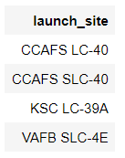
All Launch Site Names
The names of the all launch sites are:
used DISTINCT parameter to get unique results of the column launch_site from the Table SPACEXTBL:

Slide 25
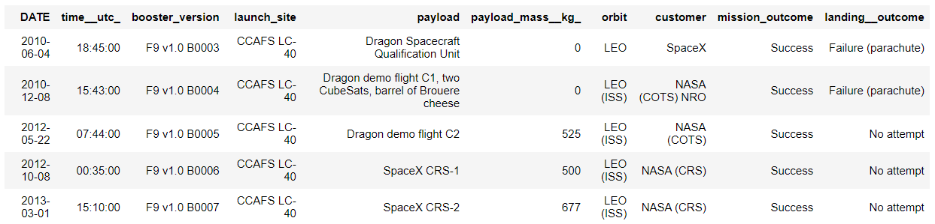
Launch Site Names Begin with 'CCA'
Table showing the first 5 starts from a launch_site that starts with “CCA”

Slide 26
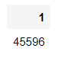
Total Payload Mass
The Sum of payload Mess carried by boosters launched by NASA (CRS):
The Query to get this result look like this:

Slide 27
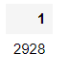
Average Payload Mass by F9 v1.1
The average payload mass carriad by booster version F9 v1.1 is 2928:
The Query to get this result look like this:

Slide 28
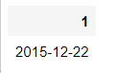
First Successful Ground Landing Date
The date of the first successful landing outcome on ground pad:
The Query to get this result look like this:

Slide 29
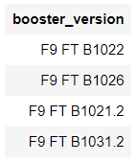
Successful Drone Ship Landing with Payload between 4000 and 6000
List of booster names, which have successfully landed on drone ship and had payload mass greater than 4000 but less than 6000:
The Query to get this result look like this:

Slide 30
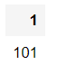
Total Number of Successful and Failure Mission Outcomes
Total number of successful and failure mission outcomes:
The Query to get this result look like this:

Slide 31
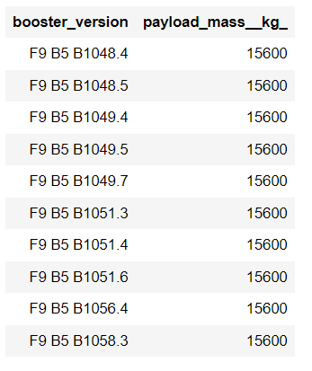
Boosters Carried Maximum Payload
List of the boosters, which have carried the maximum payload mass
The Query to get this result look like this:

Slide 32
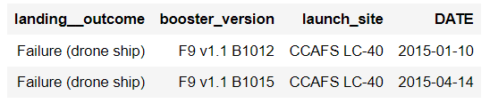
2015 Launch Records
List of the failed landing_outcomes in drone ship with the name of their booster versions, and launch site names for in year 2015:
The Query to get this result look like this:

Slide 33
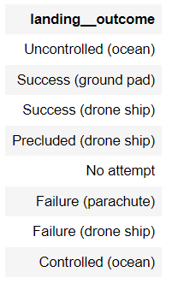
Rank Landing Outcomes Between 2010-06-04 and 2017-03-20
Rank of the categories of landing outcomes (such as Failure (drone ship) or Success (ground pad)) between the date 2010-06-04 and 2017-03-20, in descending order:
The Query to get this result look like this:

Slide 34

Section 3

Slide 35
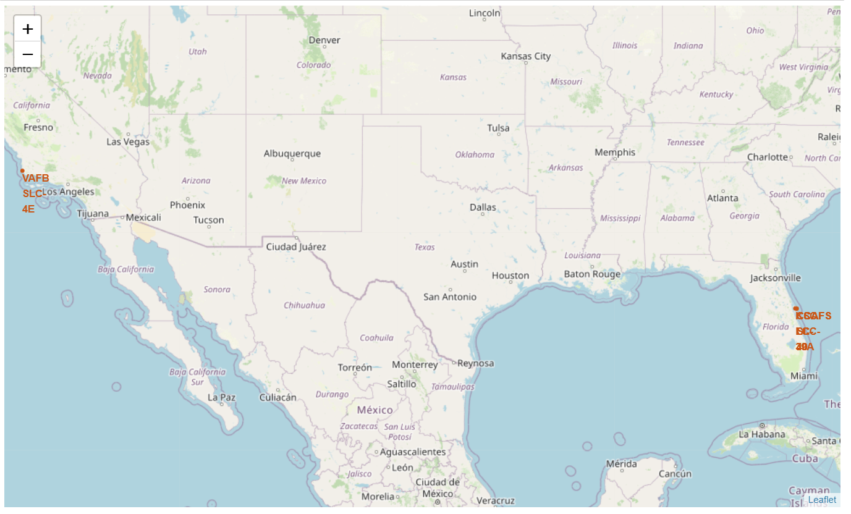
Launch Sites of Space X
On the map above are the launch sites displayed which Space X used to launch the Falcon 9 rockets, three are on the east coast in a sub-tropic area and on is at the west coast
SpaceX is so more flexibily due to bigger weather events

Slide 36
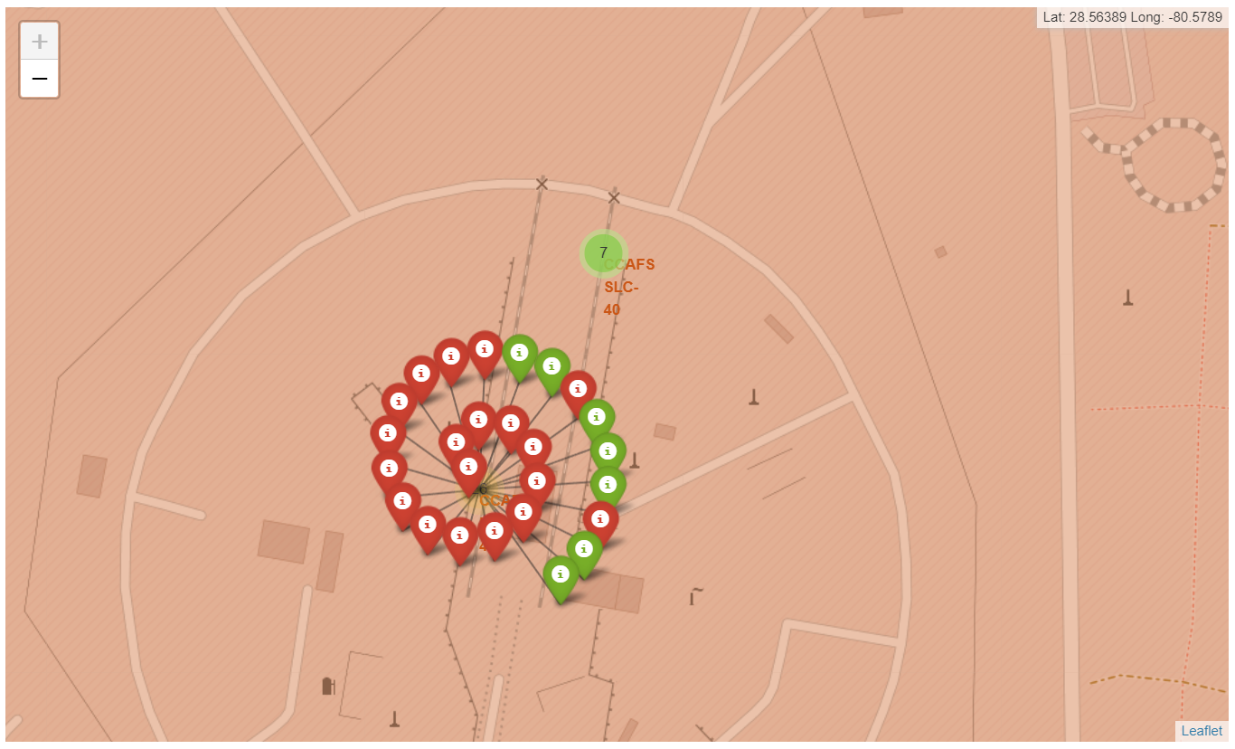
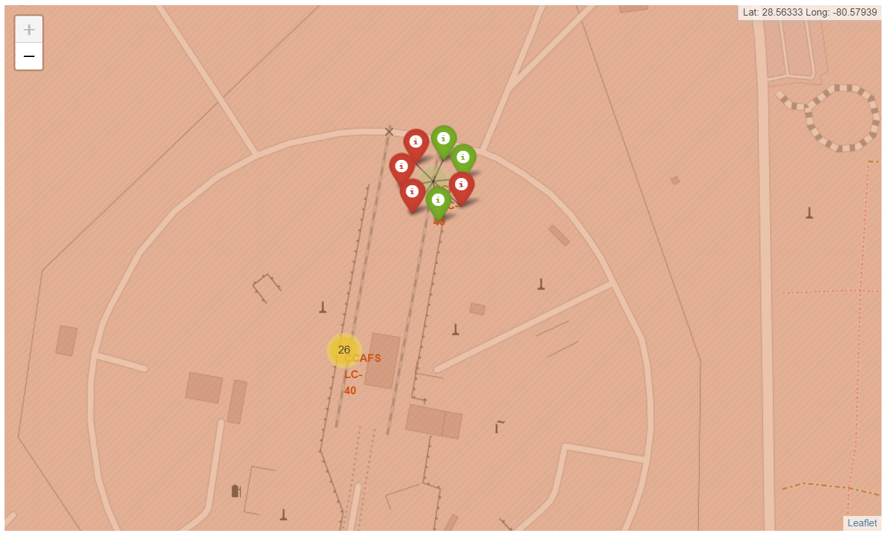
<Folium Map Screenshot 2>
The two Screenshots show the both launch sites in Florida which are located very close next to each other
The northern one was less used than the southern one

Slide 37
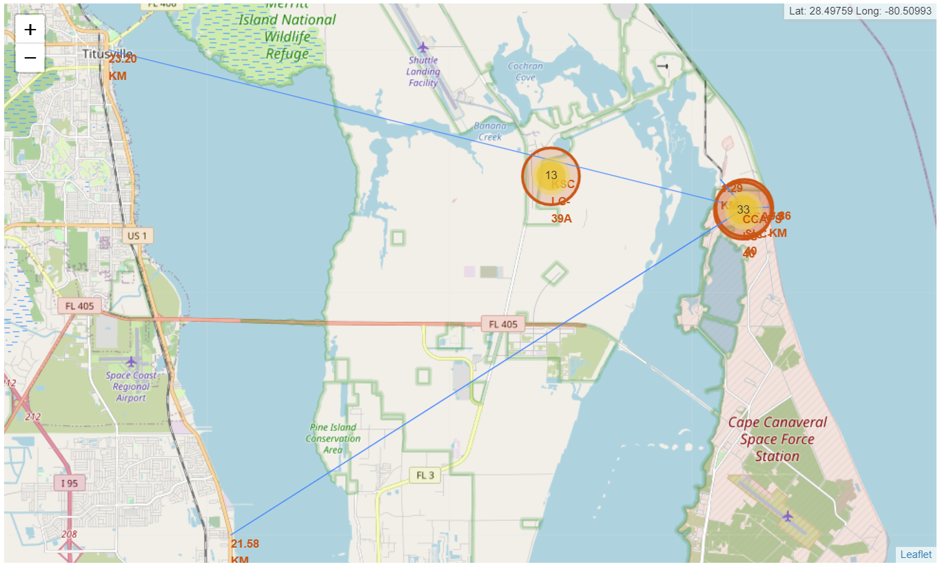
Proxmities of a launch site
The launch site are very near to the ocean and have a greater distance to highways, railways and cities
We bigger distance to highway, railways and cities are planned due to chance of a failure and the wish to keep uninvolved people safe

Slide 38

Section 4

Slide 39
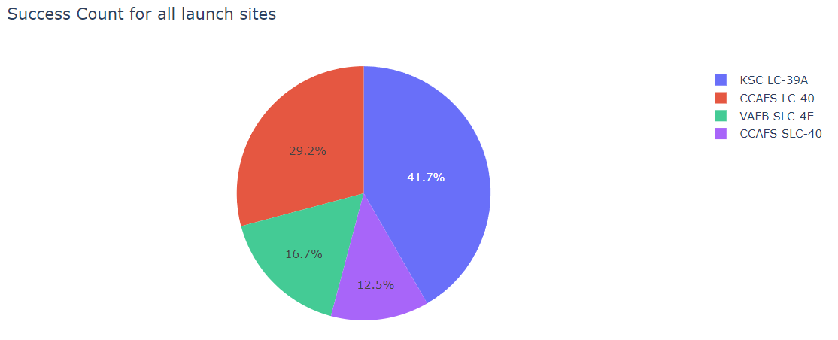
Launch success rate
The pie chart show the success count for all launch sites
KSC LC-39A have the biggest part of the success count and CCAFS SLC-40 habe the smallest part

Slide 40
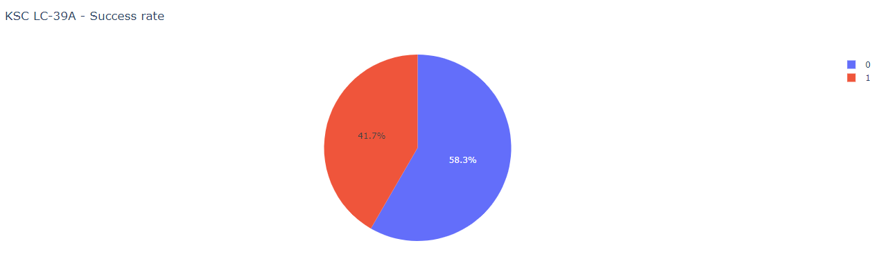
Launch site with highest launch success ratio
KSC LC-39A have the highest launch success ratio
41.7 % of the starts have a positive outome

Slide 41
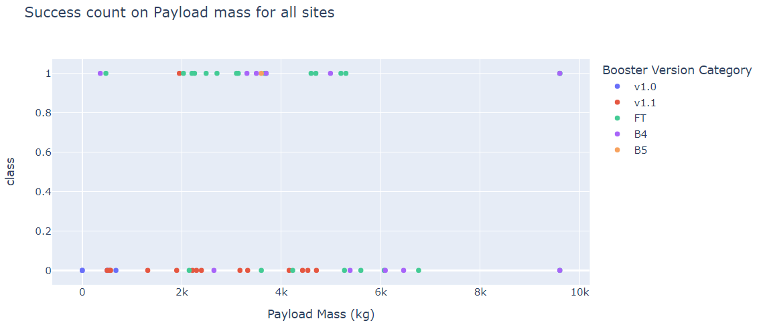
Payload vs. Launch Outcome of all Launch Sites
The Booster Version FT have the highest success rate
The Booster Version v1.0 have no positive success rate

Slide 42

Section 5

Slide 43
Classification Accuracy
KNN, SVM and Logistic Regression have the highest accracy
The result of logLoss is not comparable with the other scores

Slide 44
Confusion Matrix
That is the KNN Confusion Matrix

Slide 45
Conclusions
There is a of progress in positive launch outcomes with increasing number of launches each year
The launch sites are next to ocean and have a huge distance to the daily live, the KSC LC-39A have the highest success rate
Launches with a high payload mass have in average a higher success rate than launches with lower payload mass
The success rate was also dependent on the orbit and payload mass, we saw that ISS and VLEO orbits had a good success rate.
Support Vector Machine was a suitable model to predict if the stage one would land or not, it had an accuracy of 83%

Slide 46


